Slide 1
Stats Project 2 Notes

Slide 2
'data.frame': 41188 obs. of 22 variables:
$ age : int 56 57 37 40 56 45 59 41 24 25 ...
$ job : Factor w/ 12 levels "admin.","blue-collar",..: 4 8 8 1 8 8 1 2 10 8 ...
$ marital : Factor w/ 4 levels "divorced","married",..: 2 2 2 2 2 2 2 2 3 3 ...
$ education : Factor w/ 8 levels "basic.4y","basic.6y",..: 1 4 4 2 4 3 6 8 6 4 ...
$ default : Factor w/ 3 levels "no","unknown",..: 1 2 1 1 1 2 1 2 1 1 ...
$ housing : Factor w/ 3 levels "no","unknown",..: 1 1 3 1 1 1 1 1 3 3 ...
$ loan : Factor w/ 3 levels "no","unknown",..: 1 1 1 1 3 1 1 1 1 1 ...
$ contact : Factor w/ 2 levels "cellular","telephone": 2 2 2 2 2 2 2 2 2 2 ...
$ month : Factor w/ 10 levels "apr","aug","dec",..: 7 7 7 7 7 7 7 7 7 7 ...
$ day_of_week : Factor w/ 5 levels "fri","mon","thu",..: 2 2 2 2 2 2 2 2 2 2 ...
$ duration : int 261 149 226 151 307 198 139 217 380 50 ...
$ campaign : int 1 1 1 1 1 1 1 1 1 1 ...
$ pdays : int 999 999 999 999 999 999 999 999 999 999 ...
$ previous : int 0 0 0 0 0 0 0 0 0 0 ...
$ poutcome : Factor w/ 3 levels "failure","nonexistent",..: 2 2 2 2 2 2 2 2 2 2 ...
$ emp.var.rate : num 1.1 1.1 1.1 1.1 1.1 1.1 1.1 1.1 1.1 1.1 ...
$ cons.price.idx: num 94 94 94 94 94 ...
$ cons.conf.idx : num -36.4 -36.4 -36.4 -36.4 -36.4 -36.4 -36.4 -36.4 -36.4 -36.4 ...
$ euribor3m : num 4.86 4.86 4.86 4.86 4.86 ...
$ nr.employed : num 5191 5191 5191 5191 5191 ...
$ Subscription : Factor w/ 2 levels "no","yes": 1 1 1 1 1 1 1 1 1 1 ...

Slide 3
Emp var rate
Cons price
Cons conf
Euribor
Nr employed
Job
Education
Default
Contact
Month
Poutcome

Slide 4
There are only 3 yes defaults
PCs
1,6
1,7
1,8
Job*age -
Job*emp.var.rate -
Job*nr.employed +
Job*Euribor +
Marital*Euribor -
Workforce*nr.employed +
Previouscontact*nr.employed -
Contact*nr.employed +

Slide 5
simple
pdays + nr.employed + emp.var.rate + euribor3m + duration

Slide 6
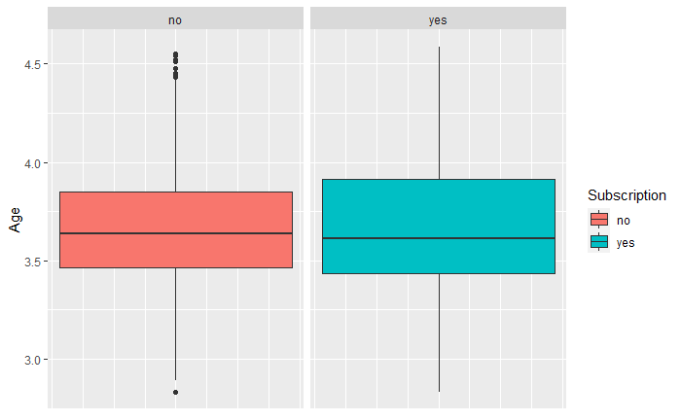
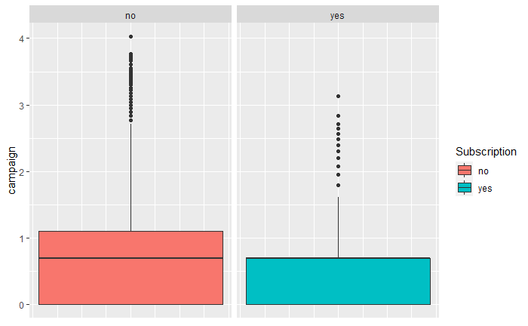
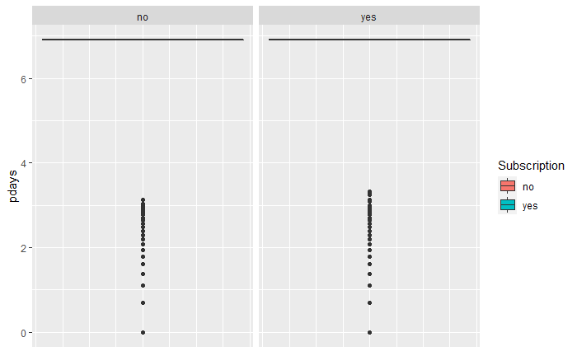
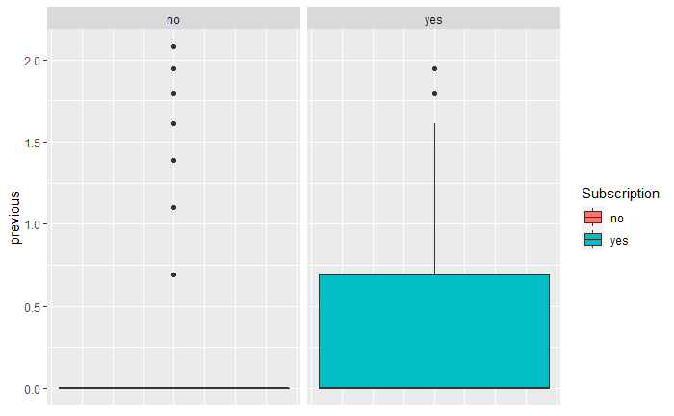
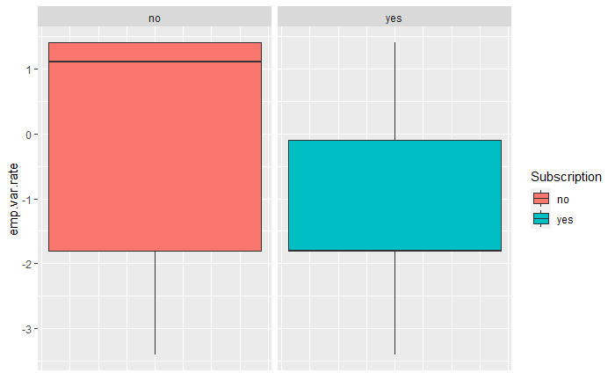
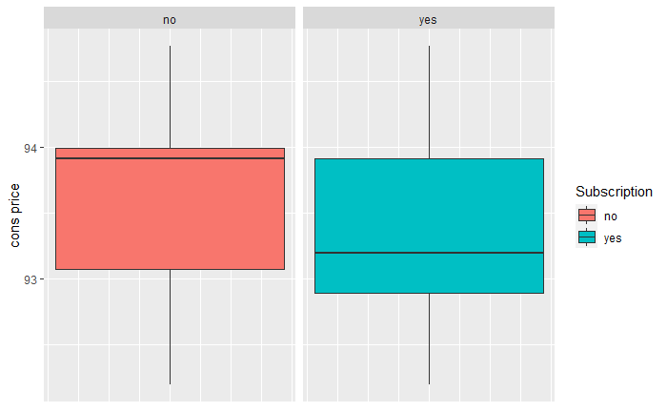
Continuous Predictors vs Response 1
Create a custom categorical
Create a custom categorical

Slide 7
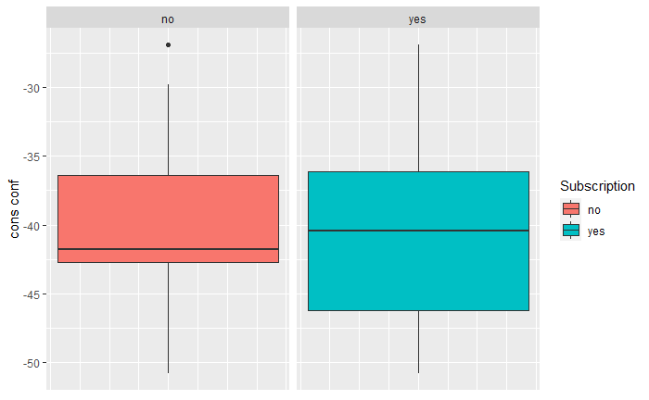
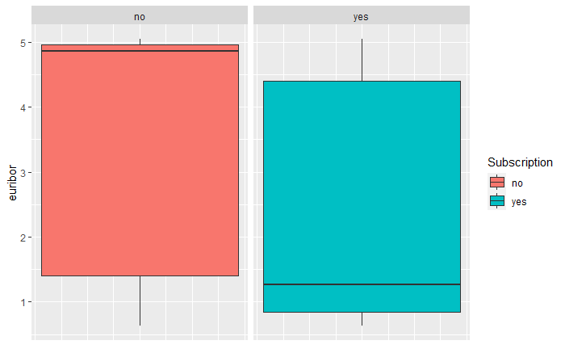
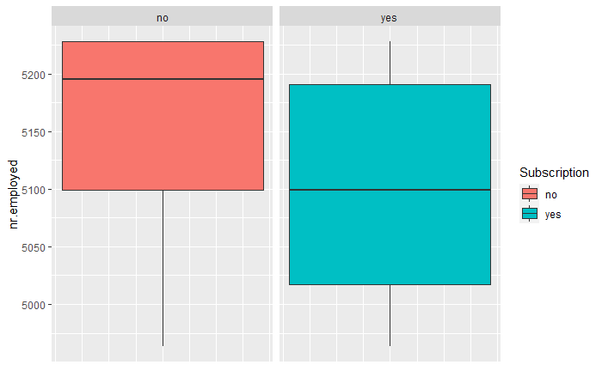
Continuous Predictors vs Response 2

Slide 8
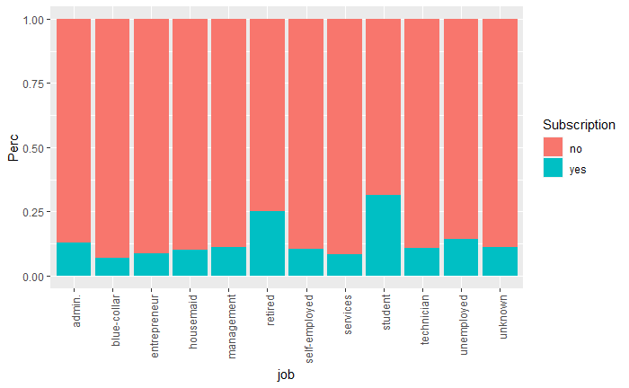
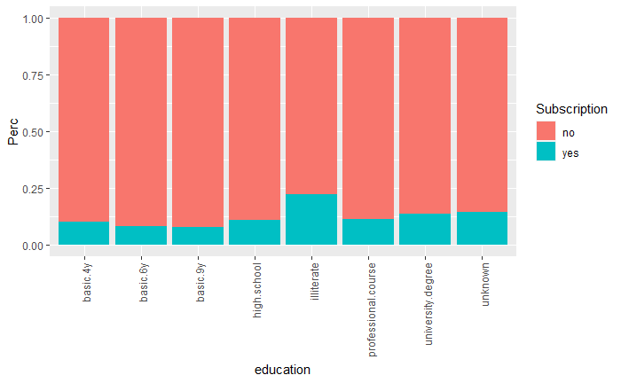
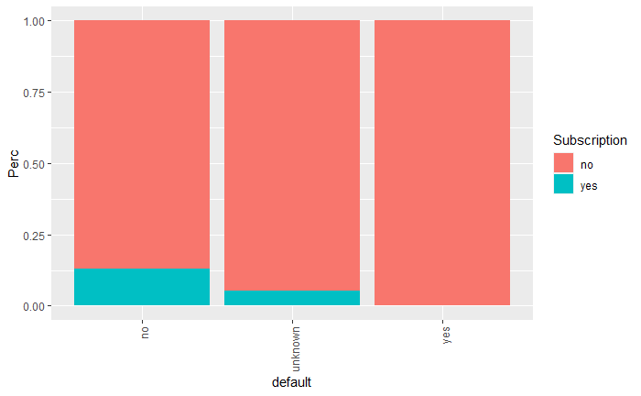
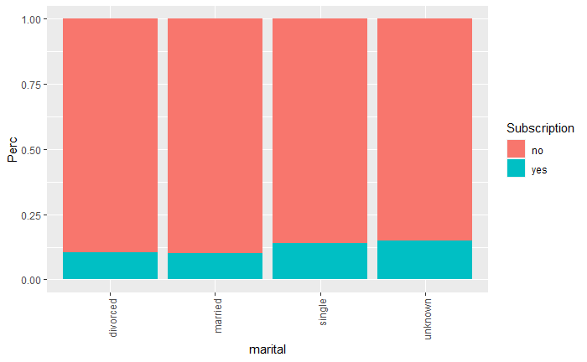
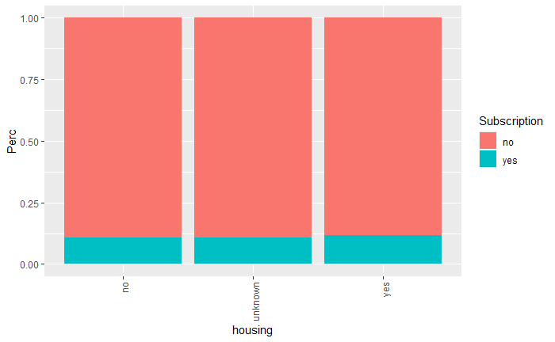
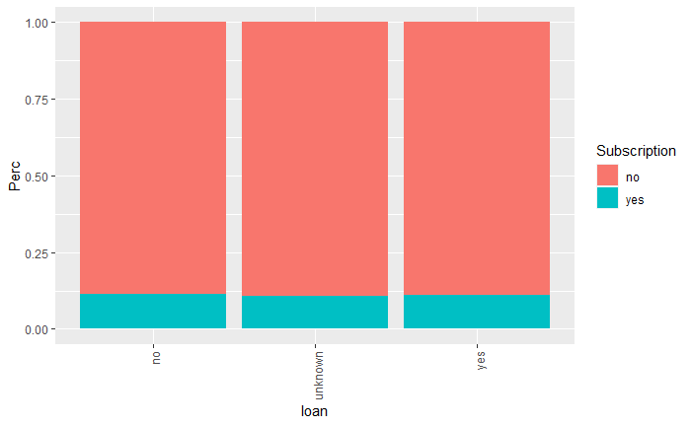
Categorical Relationship to Response 2
Split job into workforce and not (Retired, Student, unemployed)

Slide 9
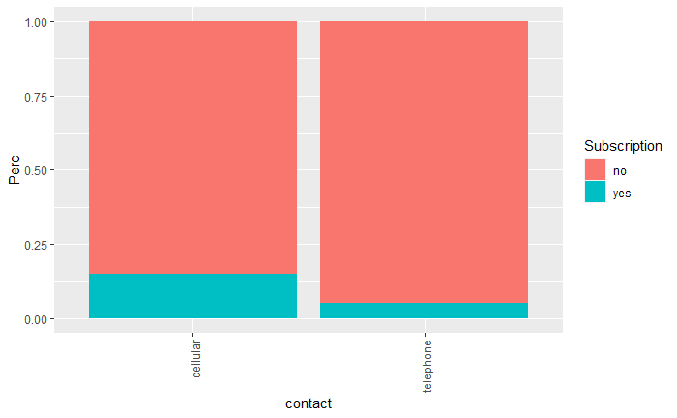
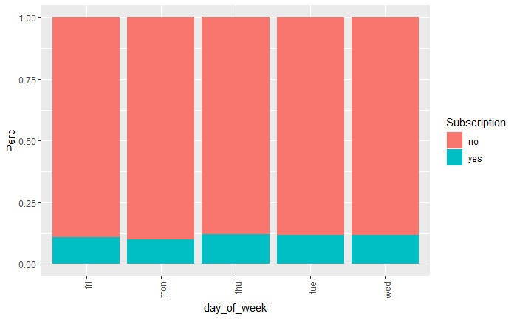
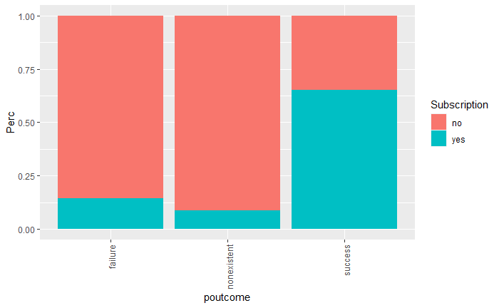
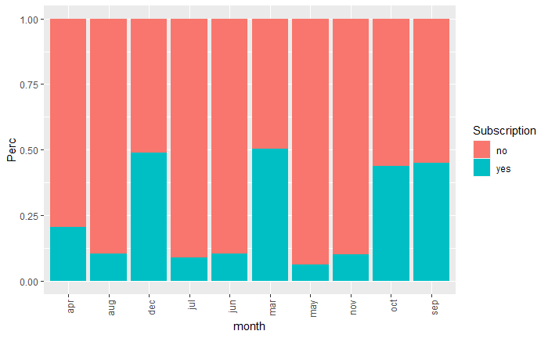
Categorical Relationship to Response
Contacted before and Uncontacted

Slide 10
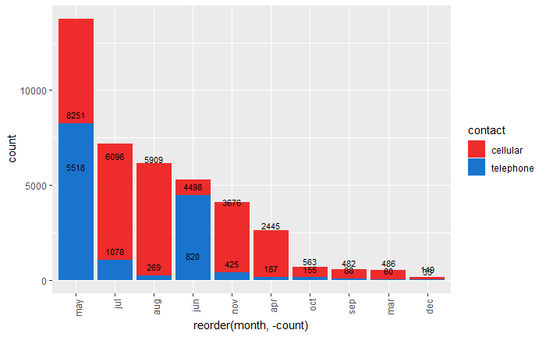
Call Type by month compared to Success Rate by Month
March, December, October, and September have the highest rates of success on calls but they are also the 4 least called months

